Slide 1

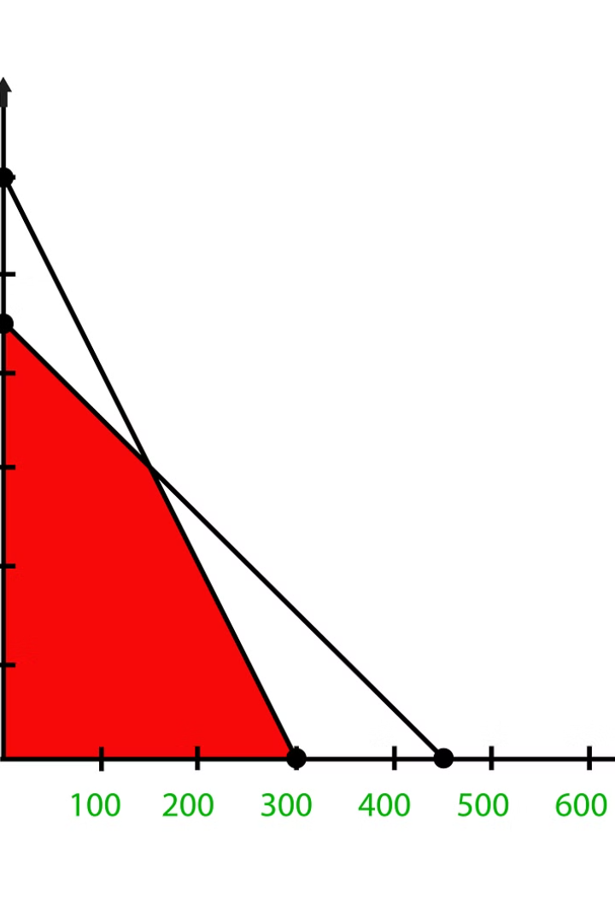

POWERPOINT PRESENTATION FOR CA1
NAME-ARPAN KUMAR SINGH
ROLL- 13000120041
SUB-OEC CS-701A
TOPIC-Overview and detailed explanation of the simplex method for solving linear programming problems

Slide 2

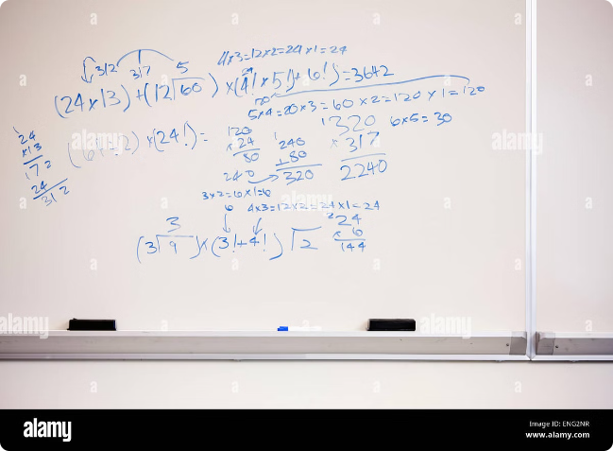
Introduction to Linear Programming
Linear programming is a mathematical technique used to optimize a linear objective function subject to linear constraints. It has wide applications in various fields, including business, engineering, and economics.

Slide 3

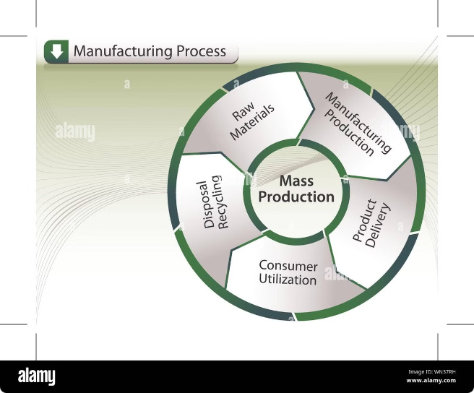
Formulating a Linear Programming Problem
Formulating a linear programming problem involves identifying the decision variables, the objective function, and the constraints. The objective function represents the quantity to be optimized, while the constraints define the limitations on the decision variables.
Decision Variables
Objective Function
Quantities that are under control and can be adjusted to achieve the objective.
Mathematical expression that represents the quantity to be optimized.
Constraints
Limitations on the decision variables, expressed as linear inequalities or equations.

Slide 4
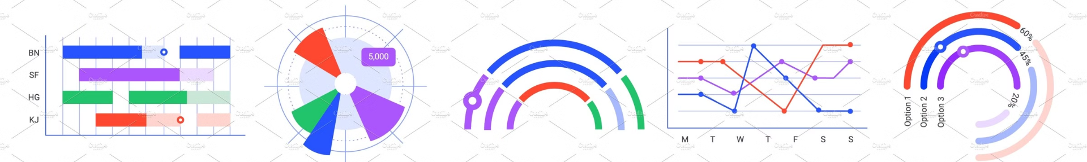
The Simplex Method
The simplex method is an iterative algorithm used to solve linear programming problems. It involves starting at a feasible solution and then moving to an adjacent feasible solution that improves the objective function value.
Optimality Check
Initialization
Check if the current solution is optimal. If not, repeat the iteration process.
Start with an initial feasible solution.
1
2
3
Iteration
Move to an adjacent feasible solution that improves the objective function value.

Slide 5
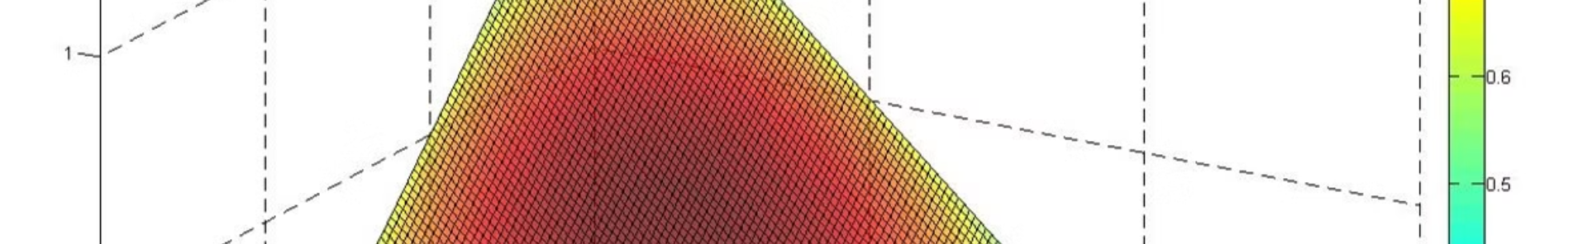




Simplex Algorithm Steps
The simplex algorithm involves a sequence of steps, including finding an initial feasible solution, identifying the entering and leaving variables, and updating the solution. The algorithm continues until an optimal solution is reached.
Step 1: Find an initial feasible solution.
Step 2: Identify entering and leaving variables.
Step 3: Update the solution.
Step 4: Check for optimality.
Adjust the values of the variables based on the entering and leaving variables.
Examine if the current solution is optimal; if not, repeat steps 2 and 3.
Begin with a feasible solution that satisfies all constraints.
Determine the variable that will enter the basis and the variable that will leave.

Slide 6
Handling Infeasible and Unbounded Solutions
In some cases, a linear programming problem may have no feasible solution or an unbounded solution. Infeasibility occurs when no solution satisfies all constraints, while unboundedness implies the objective function can increase indefinitely.
Infeasible Solution
Unbounded Solution
No solution satisfies all constraints.
Objective function can increase indefinitely.

Slide 7


Sensitivity Analysis
Sensitivity analysis examines how the optimal solution changes when the problem's parameters are varied. It helps understand the robustness of the solution and identify critical parameters.
Parameter
Impact on Optimal Solution
Objective function coefficients
May change the optimal solution but not the feasible region.
Constraint coefficients
May alter the feasible region and hence the optimal solution.

Slide 8


Applications of the Simplex Method
The simplex method finds wide applications in diverse fields, including production planning, resource allocation, transportation, and portfolio optimization. Its versatility makes it a powerful tool for decision-making.
1
Production Planning
2
Resource Allocation
Determining optimal production quantities to maximize profit.
Allocating limited resources to maximize output.
3
Transportation
4
Portfolio Optimization
Minimizing transportation costs for goods.
Creating investment portfolios that maximize returns while minimizing risk.

Slide 9





Conclusion and Key Takeaways
The simplex method is a powerful tool for solving linear programming problems. Its iterative nature allows for finding optimal solutions efficiently. Understanding the concept and steps involved in the algorithm enables effective application in various decision-making contexts.
Versatility
Wide applicability in diverse fields.
Efficiency
Iterative process for finding optimal solutions.
Sensitivity Analysis
Understanding how changes in parameters affect the solution.

